Slide 1
Climate change symposium: Call to act
23 September 2019

Slide 2
A future where we no longer contribute to Climate Change is possible
While climate change does have negative impacts, it is human choices that drive the continued use of fossil fuels, deforestation and a failure to help those in poverty to adapt
Humans are responsible for what happens in our world, both in causing the degradation of our environment and choosing to do something about it
Collectively as citizens we can develop solutions to Climate Change
Collectively we can insist that our leaders take action through ambitious legislation to protect the things we love – people and our environment
The aim of this symposium is to share how we as citizens and health professionals can become involved and take action; in fact we have a duty to do so

Slide 3
Unions call for action on Climate Change
Just Transition: There are no jobs on a dead planet
Climate proof your workplace, e.g. reduce waste and emissions
Health professionals are involved, e.g. in response to extreme weather events
Nurses, midwives, doctors are among the most trusted professionals

Slide 4
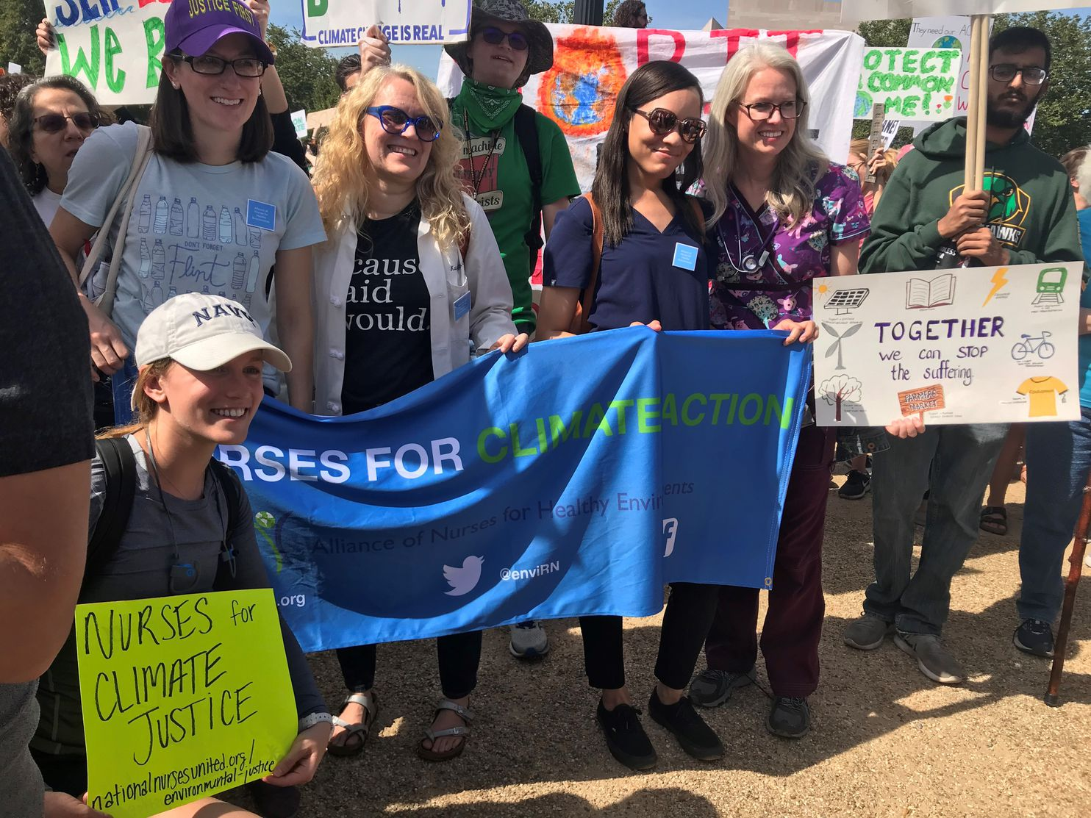
Climate strike: Nurses are seeking climate justice

Slide 5
Climate Change call for action values
Protection: Protect people’s safety and well being and protect the places we depend on, such as Pacific islands
Responsible management: Taking responsible steps to manage the issues facing our environment; thinking about future generations
Interconnection: Our fate is intertwined, e.g. the ocean is the climate’s heart
Innovation: Humans have great ability to solve problems

Slide 6
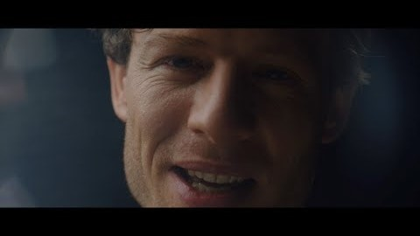

Slide 7
Looking for ways to reduce your personal carbon footprint?
https://www.theclimatecoalition.org/spin-the-love

